Slide 1
NO AMRIT, NO KIRPAN FOR ME

Slide 2
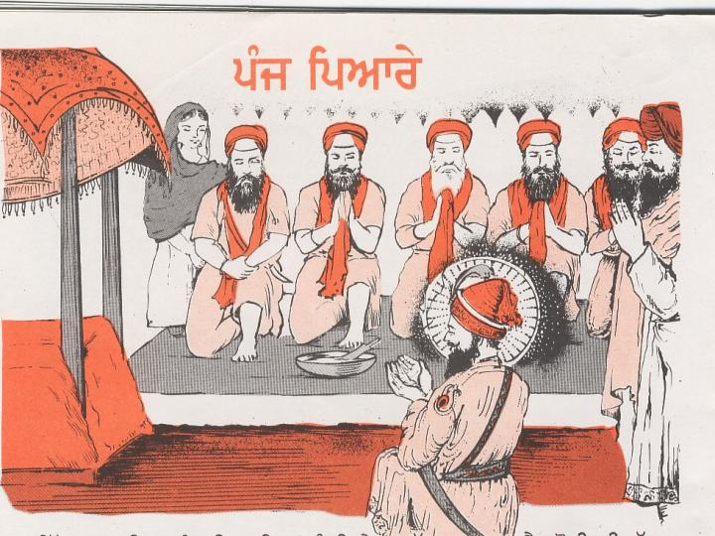
I want to take Amrit and be a 'full' Sikh.
I am, however, turned off when I see some of my friends who are Amritdhari Sikhs and wear Kirpans.
They disrespect the Guru and they disregard their vows taken before the Panj Pyaras.
Some of them tell lies, cheat, do bad things, drink alcohol publicly, and even steal gurdwara funds.

Slide 3
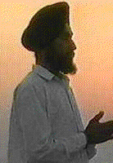
I live a clean honest Sikh life. .
I have never told a lie or cheated anyone during my business dealings.
I feel I am a better person without Amrit. Hence I think
'No Amrit, and no Kirpan for me.‘
In our society, being an Amritdhari actually means being a thug. If I take Amrit and wear a Kirpan, people will also assume me to be one of them.
Scared of that label, I do not dare to take Amrit.
I recite my Nitnem daily and commit no sin."

Slide 4
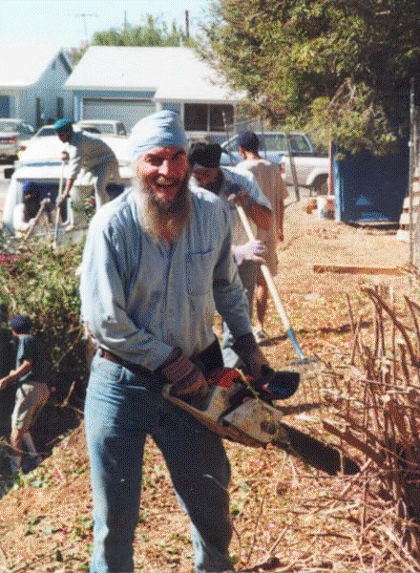
"Tell me, is taking Amrit still necessary for me?"
"Sir, surely you are a great Sikh, and there is no doubt about it.
Most of the Sikhs in the community also agree with this.
They respect you and your good life.
Actually that is why it is necessary for you to take Amrit.
It is only then that the correct image of an Amritdhari will be known to the people

Slide 5
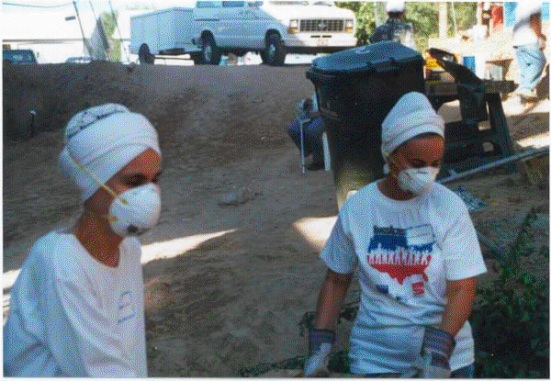
. Further, you will provide a good role model for them also.
Some thug Sikhs will feel embarrassed and may change.
Others will be criticized by the Sikh community and considered hypocrites.
Is it not a good way to build the image of the Sikh community and provide self-esteem for the Sikh community?"

Slide 6
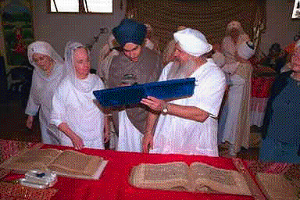
Experience with such Sikhs tells us that it is simply reluctance on the part of many Sikhs that keeps them non-Amritdhari.
Such persons, who take courage to go in for Amrit, later confess that ignorance was the cause of their reluctance.
Earlier, they feared that they may not be able to live up to their vows.
However, it was no problem to practice the Sikh Reht.
Rather, it helped them to move straight on to the Sikh highway and it stops them from taking wrong exits.

Slide 7
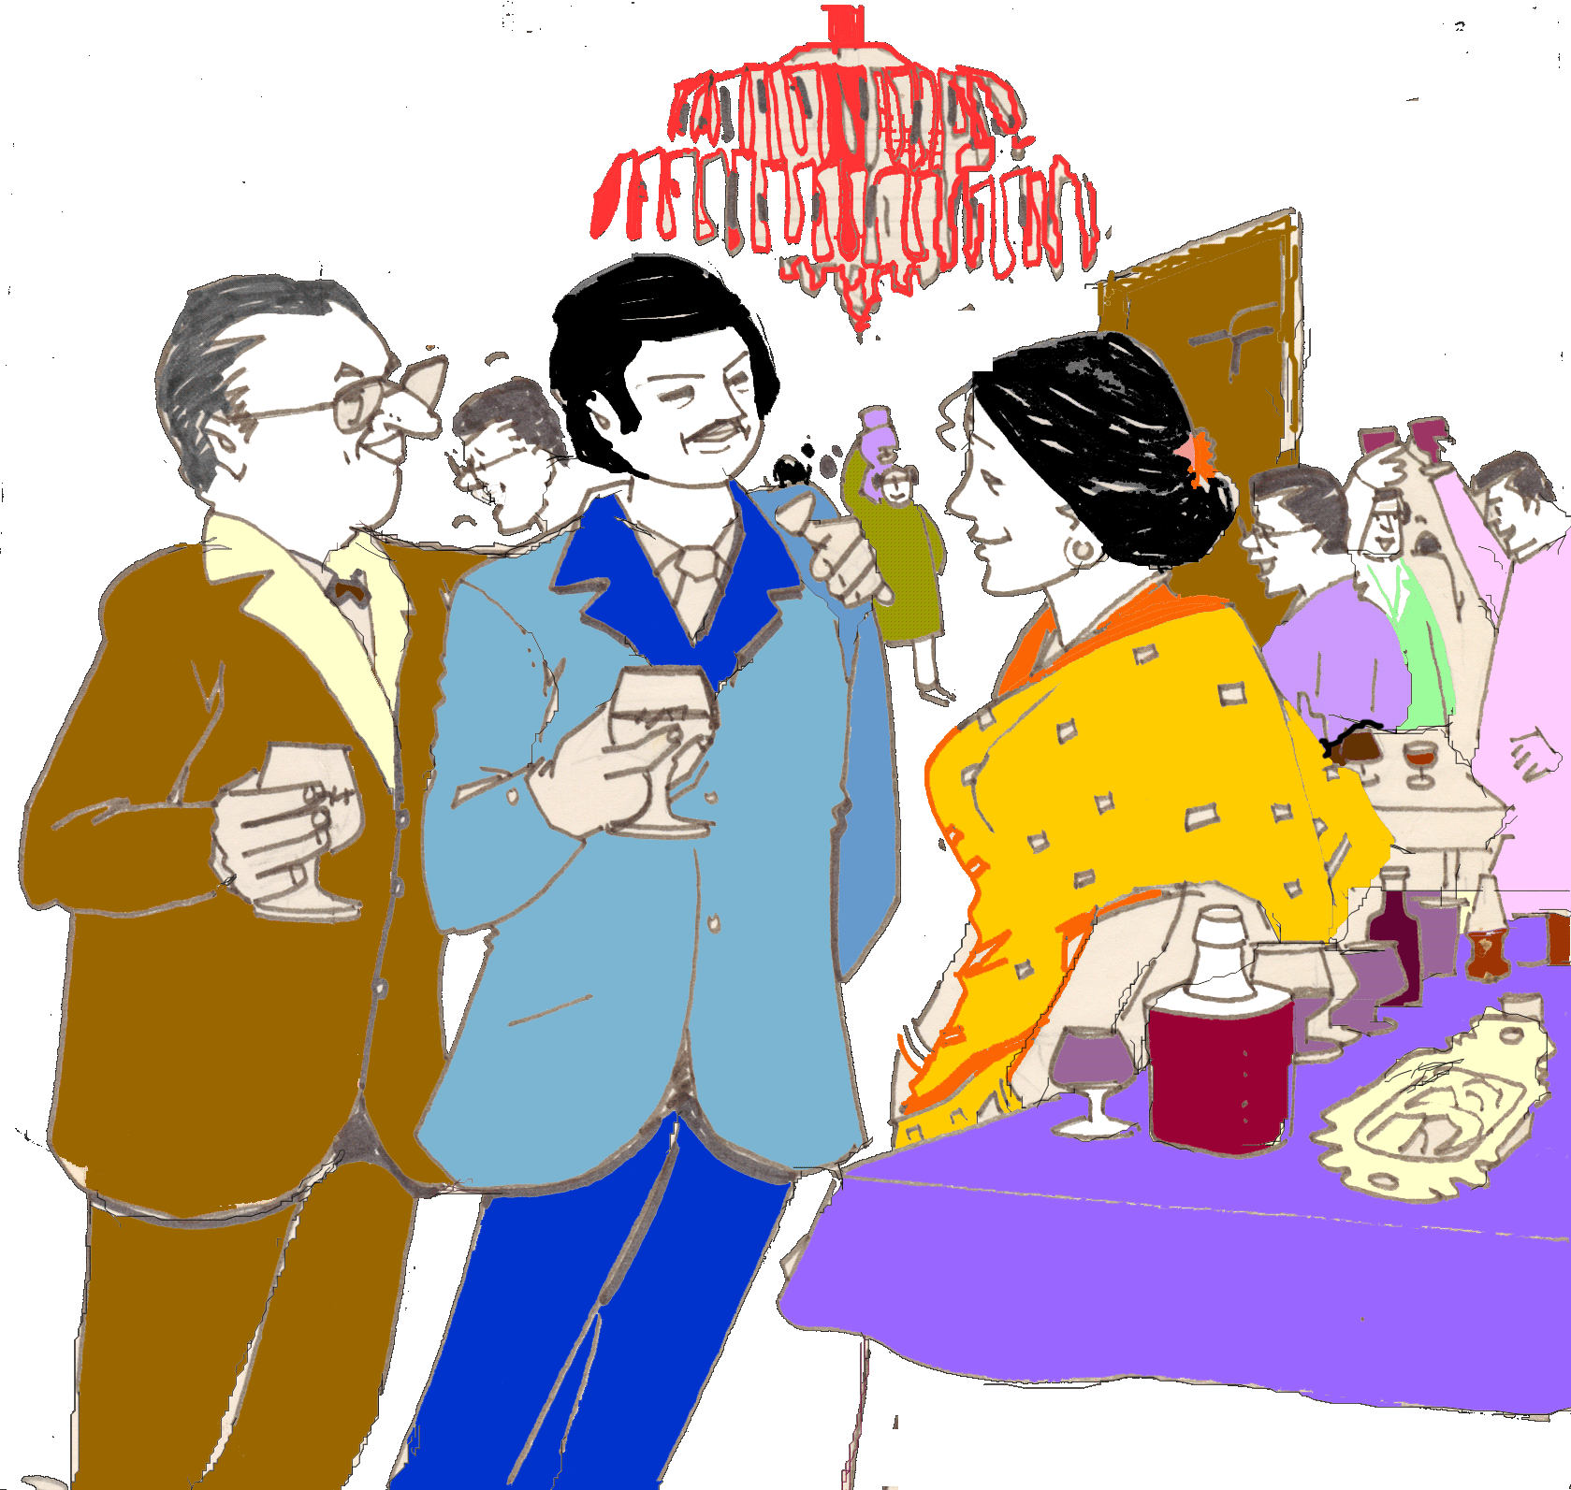
Each such Sikh had his own reasons for being happy after taking Amrit.
"Whenever there was a function in our family, it was very hard for me to justify my not drinking liquor.
Now, a few words, I have taken Amrit, are more than enough to save me from repeated pressures of my friends.
Further, I do not feel guilty for disregarding the requests of almost everyone at the function and they do not feel disrespected if I do not agree to join them."

Slide 8
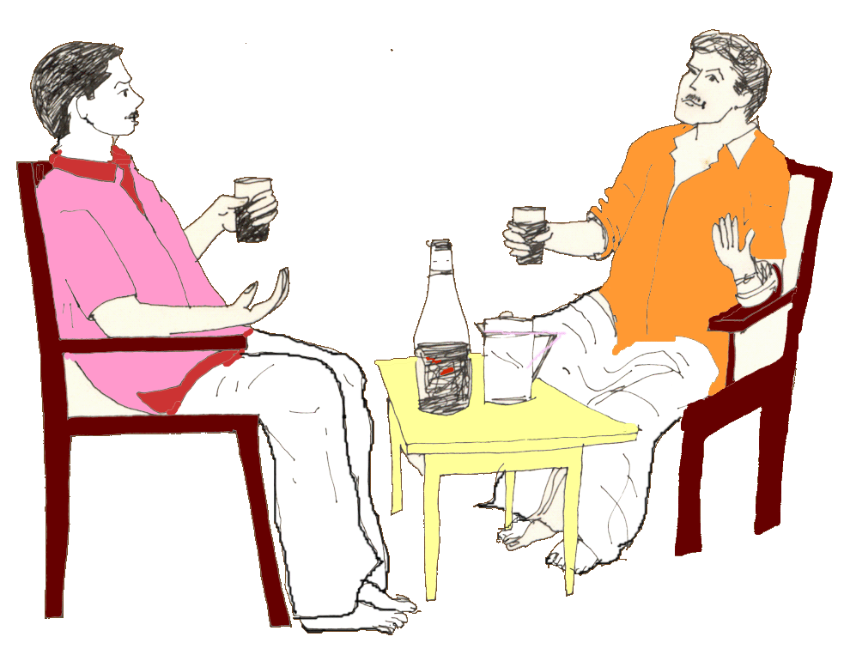
Another person felt that he started enjoying his regular life only after taking Amrit.
"Many times in our society, we waste this precious life just sitting and talking trash. When you want to leave, your friends force you to continue to sit by asking, "Ki Kahli hai? - What is the haste? ".
Now I leave after saying, 'It is Rehras time. We have to recite it together in our family.'
By saying this, I get rid of their pressure to force me to waste my time there.
Another lady said, "Now, we enjoy every evening. Earlier, a friend or two might come and start drinking and bothering us many times a week."

